Slide 1

A Graphical Helper Tool for Streamlining
Use of InterSystems Cloud Manager
Rameel Rizvi, ISC Intern 2017

Slide 2

About the Author
Intern in QD department
Rising junior, Carnegie Mellon University (Pittsburgh, PA)
Pursuing B.S. in Computer Science
From central Long Island, New York

Slide 3
Cloud Manager Overview
Previously IPD: Infrastructure, Provisioning, Deployment
Deploys sharded Caché clusters
Efficient & Convenient: sets your machines up for you!
AM
AM
DM
QS
QS
QS
QS
DS
DS
DS
Notes:
Big data is too big for one machine—need to distribute it among multiple machines.

Slide 4
Configuration: the Downside
Infrastructure: definitions.json & defaults.json
Typo-prone, clunky blocks of text
Pain to deal with! Look ☹
definitions
defaults
Notes:
Config files are complex—barrier to adoption.

Slide 5
Project: Tool in Action
Parameter input fields with form validation ⟵
Dynamic preview window of current configuration
Can even edit preview window directly!
Import an existing file to use as baseline
Download files directly once you’re all set
View topology of corresponding cluster setup

Slide 6
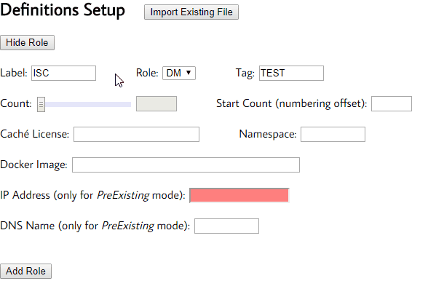

Slide 7
Project: Tool in Action
Parameter input fields with form validation
Dynamic preview window of current configuration ⟵
Can even edit preview window directly!
Import an existing file to use as baseline
Download files directly once you’re all set
View topology of corresponding cluster setup

Slide 8
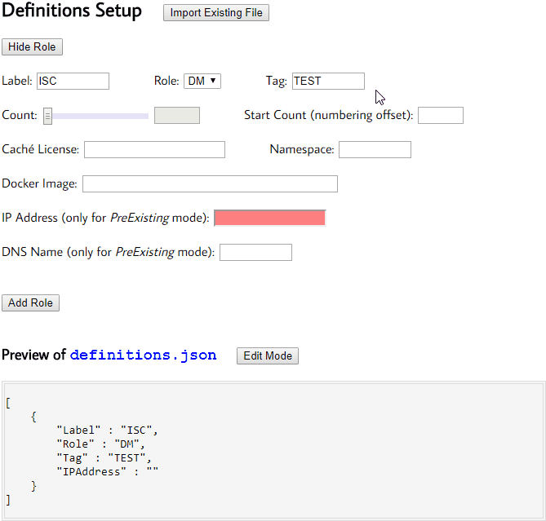

Slide 9
Project: Tool in Action
Parameter input fields with form validation
Dynamic preview window of current configuration
Can even edit preview window directly! ⟵
Import an existing file to use as baseline
Download files directly once you’re all set
View topology of corresponding cluster setup

Slide 10
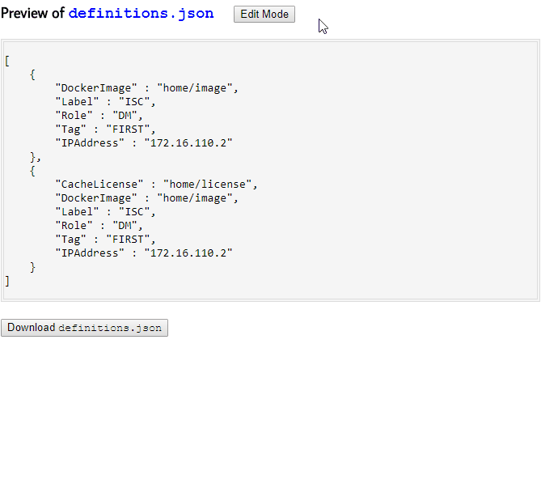

Slide 11
Project: Tool in Action
Parameter input fields with form validation
Dynamic preview window of current configuration
Can even edit preview window directly!
Import an existing file to use as baseline ⟵
Download files directly once you’re all set
View topology of corresponding cluster setup

Slide 12
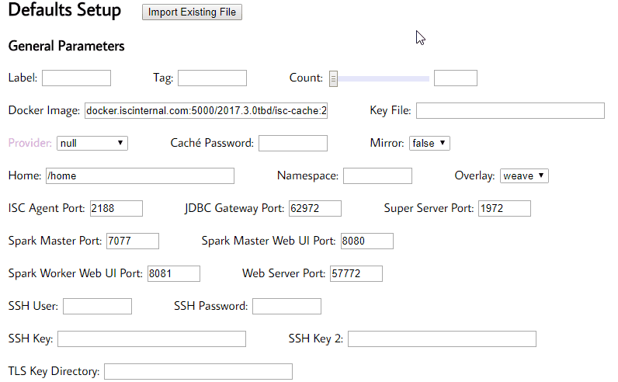

Slide 13
Project: Tool in Action
Parameter input fields with form validation
Dynamic preview window of current configuration
Can even edit preview window directly!
Import an existing file to use as baseline
Download files directly once you’re all set ⟵
View topology of corresponding cluster setup

Slide 14
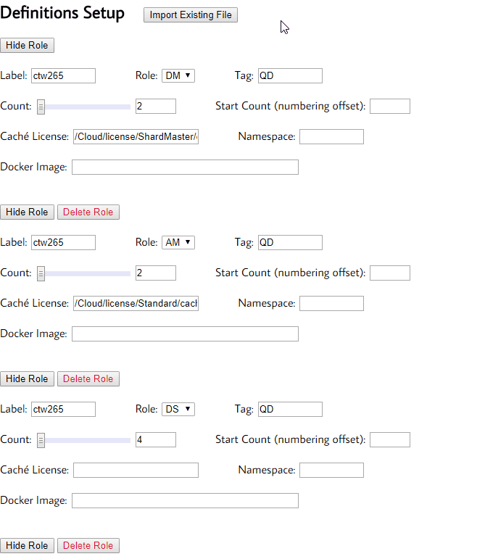

Slide 15
Project: Tool in Action
Parameter input fields with form validation
Dynamic preview window of current configuration
Can even edit preview window directly!
Import an existing file to use as baseline
Download files directly once you’re all set
View topology of corresponding cluster setup ⟵

Slide 16
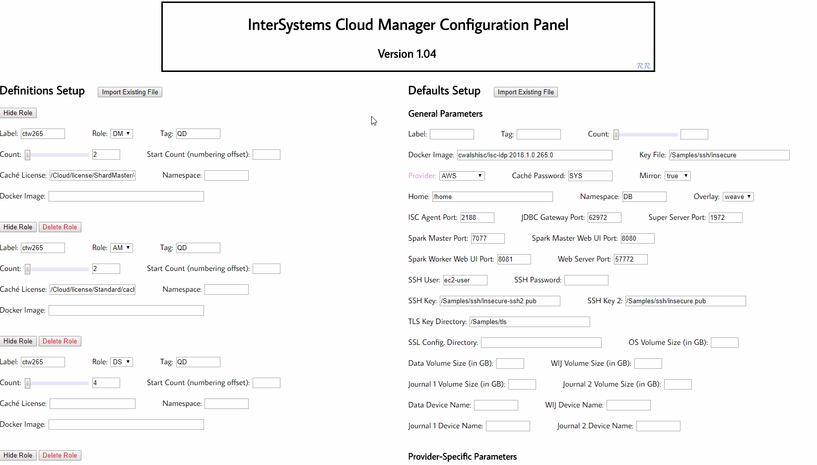

Slide 17
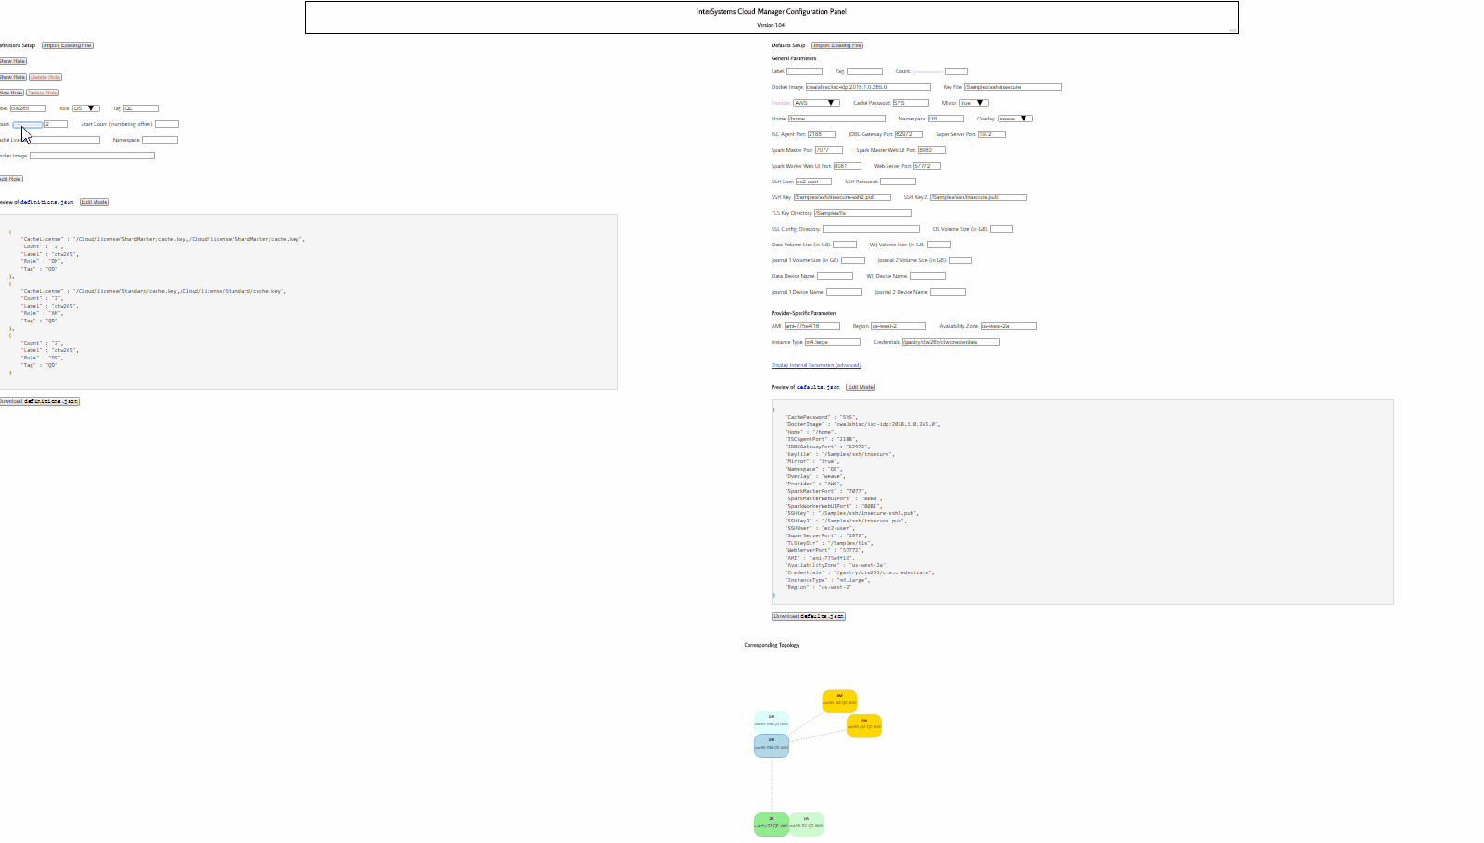

Slide 18

Acknowledgments, Questions
Mentors: Farbod Khaghani, Conor Walsh
Thanks everyone at ISC!

